Slide 1

The Data Ecosystem: A Comprehensive Guide
Navigating the complexity of the data landscape
Notes:
In today's data-driven world, understanding the data ecosystem is crucial for businesses and organizations. In this presentation, we will explore the fundamentals of the data ecosystem, including cloud storage, integration and interoperability, and real-world applications.

Slide 2

Agenda Items
Cloud Storage in the Data Ecosystem
Integration and Interoperability in the Data Ecosystem
Case Studies and Applications of the Data Ecosystem
Notes:
In this presentation, we will start by examining the basics of cloud storage in the data ecosystem, including the different types of cloud storage platforms and security considerations. Then, we will dive into the importance of integration and interoperability in the data ecosystem, including the role of data governance and data quality. Finally, we will explore real-world case studies and applications of the data ecosystem.

Slide 3
Cloud Storage in the Data Ecosystem
Notes:
Cloud storage has revolutionized the way businesses store and manage data. In this section, we will explore the basics of cloud storage, including the different types of cloud storage platforms and their applications in big data. We will also examine the importance of security in cloud data storage.

Slide 4

Cloud Data Storage Basics
Scalability
  Cloud data storage allows businesses to easily scale their data storage capacity up or down depending on their current needs, without having to invest in costly infrastructure.
Cost Savings
  Cloud data storage eliminates the need for businesses to invest in expensive local hardware, saving them money on infrastructure and maintenance costs.
Notes:
Cloud data storage allows businesses to store and manage data in remote servers, rather than on local hardware. This provides scalability and cost savings for businesses of all sizes.

Slide 5
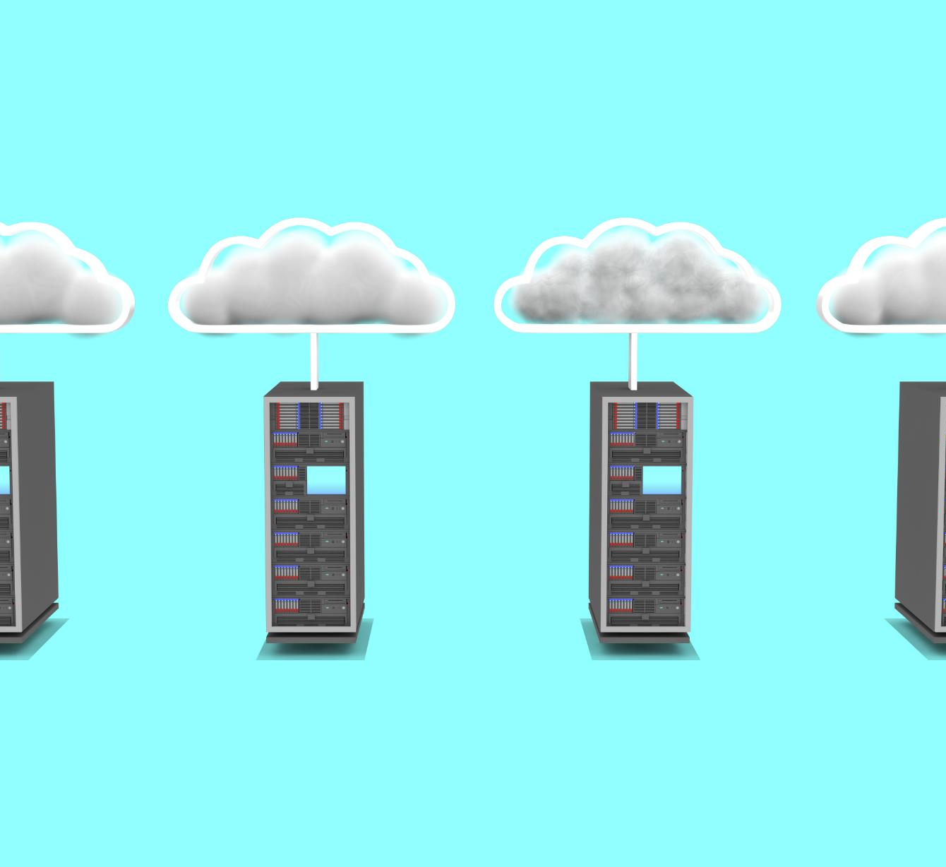
Types of Cloud Storage
Public Cloud
  Public cloud storage is a type of cloud computing where the storage service is provided by a third-party provider over the internet. It is typically affordable and scalable, making it ideal for small and medium-sized businesses.
Private Cloud
  Private cloud storage is a type of cloud computing where the storage service is provided by a dedicated infrastructure that is managed by the business. It is typically more secure and customizable, making it ideal for large enterprises.
Hybrid Cloud
  Hybrid cloud storage is a type of cloud computing that combines both public and private cloud services. It allows businesses to take advantage of the benefits of both types of cloud storage while minimizing their disadvantages.
Notes:
There are different types of cloud storage platforms, including public, private, and hybrid clouds. Each has its own advantages and disadvantages, depending on the needs of the business.

Slide 6
Cloud Data Platforms
  Cloud data platforms offer businesses a comprehensive suite of tools for data management, analytics, and reporting, making them scalable and customizable to meet the needs of businesses of all sizes.
Notes:
Cloud data platforms provide businesses with a comprehensive suite of tools for data management, analytics, and reporting. These platforms are scalable and customizable, making them ideal for businesses of all sizes.

Slide 7
Cloud Storage and Big Data
  Cloud storage platforms offer scalability and flexibility, making them ideal for managing big data. The ability to easily add more storage and computing resources as needed allows businesses to better manage and analyze large amounts of data.
Notes:
Cloud storage platforms are ideal for managing big data, as they provide the scalability and flexibility needed to store, manage, and analyze large amounts of data.

Slide 8

Security in Cloud Data Storage
Encryption
  Encryption is a security measure that can be implemented in cloud data storage to protect sensitive data from unauthorized access. It involves the use of algorithms to encode data to make it unreadable for unauthorized users.
Access Controls
  Access controls are security measures that limit the access to data based on user roles and permissions. It can be implemented in cloud data storage to prevent unauthorized access to sensitive data.
Monitoring
  Monitoring is a security measure that involves the continuous monitoring of cloud data storage to detect and respond to security threats and data breaches. It helps businesses to ensure that their data is secured and protected from cyber threats.
Notes:
Security is a critical consideration in cloud data storage. Businesses need to ensure that their data is protected from cyber threats, data breaches, and unauthorized access. There are several security measures that can be implemented, including encryption, access controls, and monitoring.

Slide 9
Trends in Cloud Storage
  Cloud storage is an ever-evolving field, and businesses need to stay up-to-date with the latest trends and technologies to remain competitive and take advantage of the latest innovations.
Notes:
Cloud storage is constantly evolving, with new trends and technologies emerging all the time. Businesses need to stay up-to-date with these trends to remain competitive and take advantage of the latest innovations.

Slide 10
Integration and Interoperability in the Data Ecosystem
Notes:
Integration and interoperability are essential components of the data ecosystem, enabling businesses to access and combine data from different sources. In this section, we will explore the importance of data governance and data quality in achieving integration and interoperability.

Slide 11

Interoperability of Different Data Sources
Definition of Interoperability
  Interoperability refers to the ability of different data systems to work together seamlessly. It enables businesses to combine data from different sources, such as CRM systems, social media platforms, and web analytics tools.
Benefits of Interoperability
  Interoperability enables businesses to gain a more complete picture of their customers and operations by combining data from different sources. This can lead to better decision-making, improved customer experiences, and increased efficiency.
Notes:
Interoperability refers to the ability of different data systems to work together seamlessly. It enables businesses to combine data from different sources, such as CRM systems, social media platforms, and web analytics tools, to gain a more complete picture of their customers and operations.

Slide 12
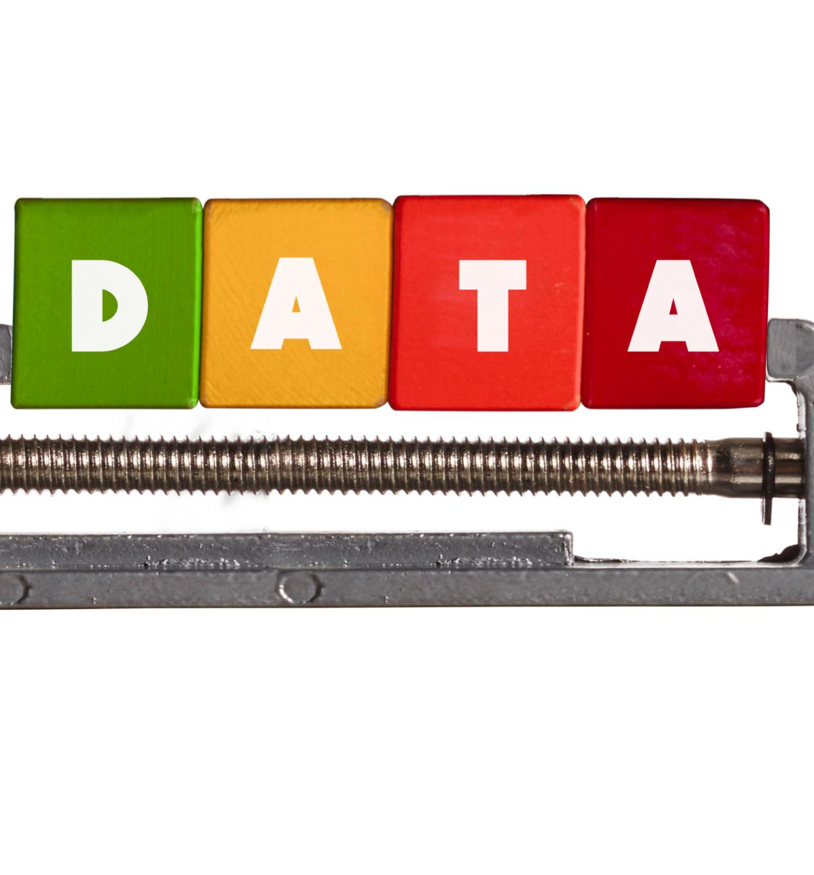
Data Governance and Data Quality
Data Governance
  Data governance is the process of managing the availability, usability, integrity, and security of data used in an organization. It involves establishing policies, procedures, and standards for data management to ensure consistent and accurate use of data.
Data Quality
  Data quality refers to the accuracy, completeness, and consistency of data. It ensures that data is fit for purpose and can be used effectively for decision-making, analysis, and reporting.
Notes:
Data governance and data quality are critical components of the data ecosystem, ensuring that data is accurate, consistent, and usable. Data governance involves establishing policies and procedures for data management, while data quality refers to the accuracy, completeness, and consistency of data.

Slide 13
Case Studies and Applications of the Data Ecosystem
Notes:
In this final section, we will explore real-world case studies and applications of the data ecosystem, demonstrating how businesses are using data to drive innovation and growth.

Slide 14

Real-World Applications
Predictive Analytics
  Predictive analytics is being used by businesses to forecast consumer behavior and trends, optimizing marketing campaigns and increasing sales.
Supply Chain Optimization
  Data analytics is being used to optimize supply chain management, reducing costs, and improving efficiency.
Customer Segmentation
  Customer segmentation is being used by businesses to identify and target specific groups of consumers with personalized marketing campaigns, improving customer satisfaction and loyalty.
Notes:
Data is being used in a wide range of applications, from predicting consumer behavior to optimizing supply chain management. We will explore some of the most exciting and innovative applications of data in the business world.

Slide 15
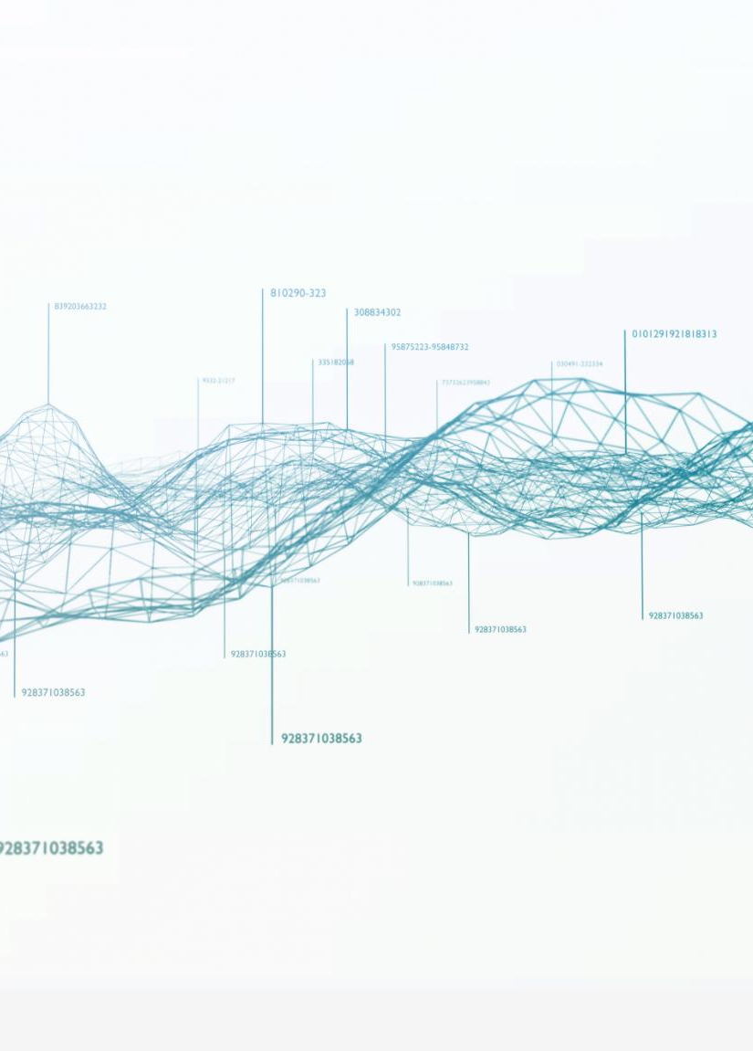
Success Stories of Modern Data Ecosystems
Netflix
  Netflix uses data to personalize user experience and recommend new content, which has helped them grow their user base and revenue.
Amazon
  Amazon uses data to optimize its supply chain, resulting in faster delivery times and lower costs.
Spotify
  Spotify uses data to personalize music recommendations and create personalized playlists, which has helped them grow their user base and revenue.
Notes:
There are many examples of businesses that have successfully leveraged the data ecosystem to drive growth and innovation. We will examine some of these success stories, highlighting the key strategies and technologies that were used.

Slide 16
Conclusion
  Understanding the fundamentals of cloud storage, integration and interoperability, and real-world applications is crucial for businesses looking to harness the power of data to drive growth and innovation.
Notes:
The data ecosystem is a complex and constantly evolving landscape. By understanding the fundamentals of cloud storage, integration and interoperability, and real-world applications, businesses can harness the power of data to drive growth and innovation.

